Slide 1
Project on data analysis and visualisation
(Proof of concept)

Slide 2
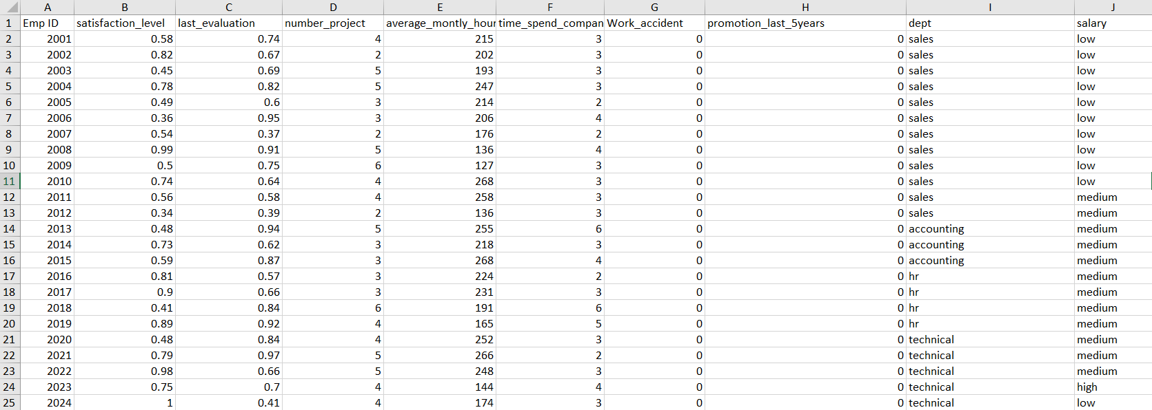
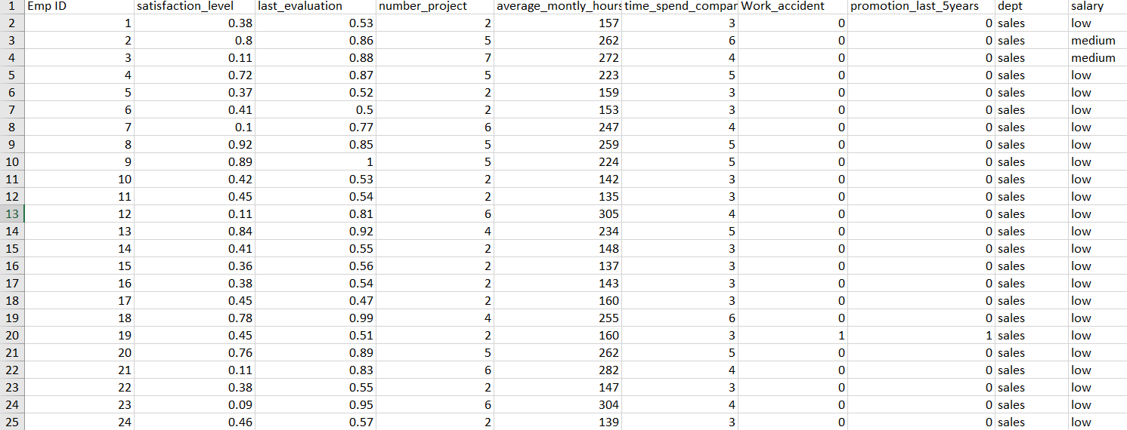
Description of the data- We were given two separate sheets in an excel file that consisted information about the people who left the company and the existing employees. The goal was to perform an analysis on the data to determine: 1. What type of employees are leaving 2. What type of employees are prone to leave next
The existing employees data:
The people who have left:

Slide 3
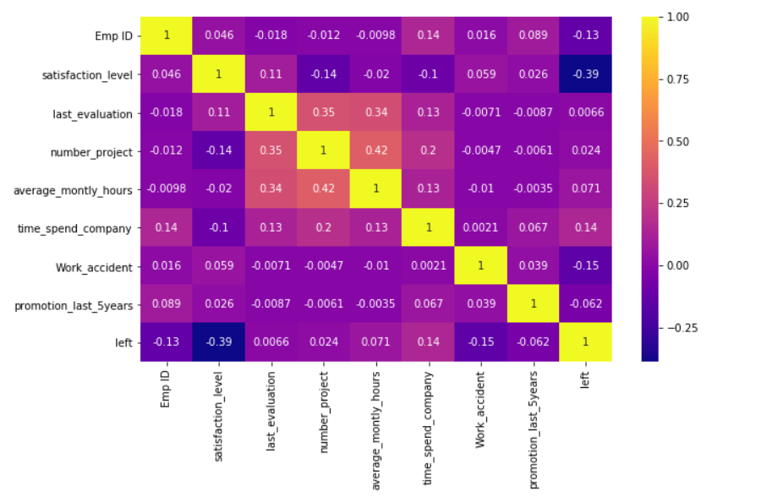
In order to visualize the tendency of leaving we combined both the data , adding a new column named left and marked it as zero for the existing employees and 1 as the employees who have left. After doing that , we plotted a correlation matrix(or heatmap) for the data.
We can see that the left column has a strong negative correlation with the satisfaction level, so we can say that as the satisfaction level decreases the tendency to leave the company increases. In order to be sure of the above fact, we further plotted a count plot of the satisfaction level and categorised it on the basis of the “left” column.

Slide 4
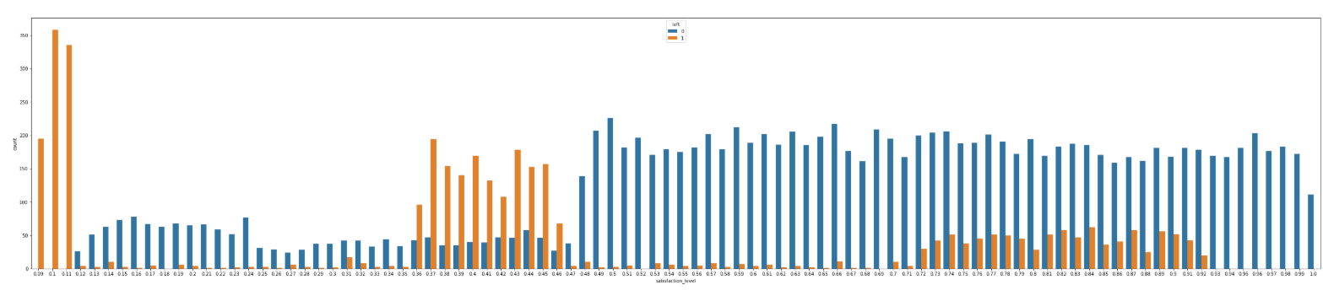
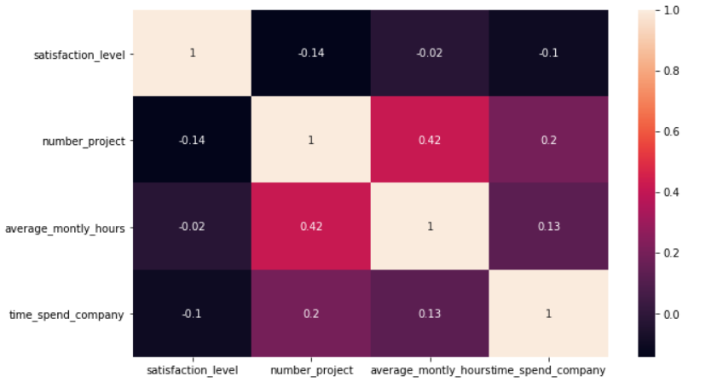
If we observe the count plot we can see that there is a great tendency to leave as the satisfaction level decreases and hence we can conclude that our assumption on the basis of correlation was appropriate. Now , we needed to determine the factors that contributed to the job satisfaction. In order to do so, I made a correlation matrix with the features that led to the decrease in job satisfaction on their respective increments and visualized those features as number of projects , time spend in the company and average monthly hours.

Slide 5
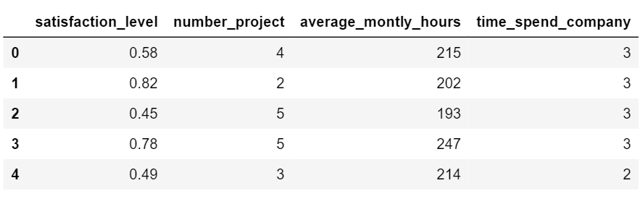
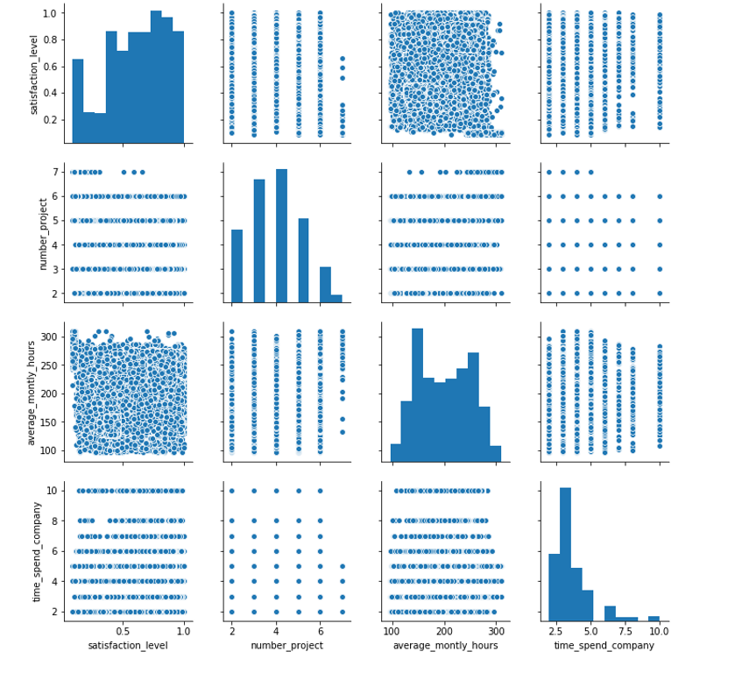
The heatmap provides a very basic information about the relative change between the parameters . In order to have a better visualization , firstly we created a data frame with the features as job satisfaction, number of projects, average monthly hours and the time spend in the company.
Then we plotted a pair plot provided by the seaborn library to see the dependencies of the various features with job satisfaction.

Slide 6
The average monthly hours has a correlation close to zero with the satisfaction level and can be eliminated as the important factor for determining the job satisfaction. Now we are left with only two parameters that is the number of projects and job satisfaction . Hence , we can conclude that the tendency of an employee to leave the company is increasing with the decrease in job satisfaction and the primary reason for that is the increase in the number of projects that is being given to them.
CONCLUSION -1 :-
This conclusion was based on the important parameters as suggested by the visualisation in determining the type of employees that are leaving . Now, let us come to the second part as to what kind of employees will leave.
In order to determine this, we did a further visualization on the remaining parameters in the data like the dept , salary and so on.

Slide 7
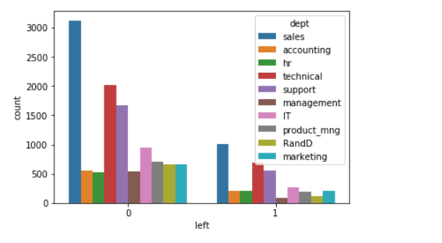
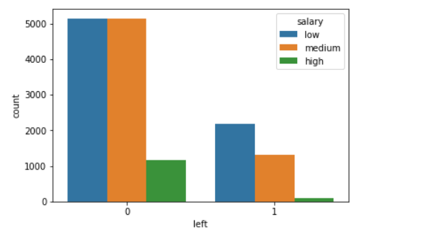
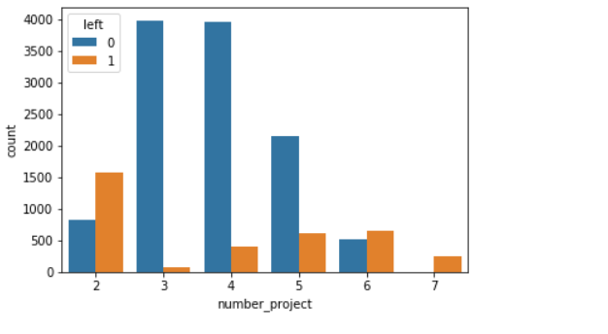

Slide 8
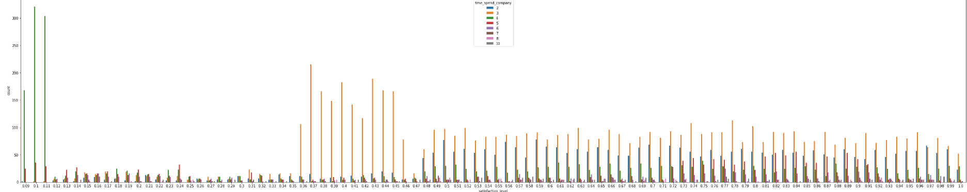
CONCLUSION 2:-
So, looking at these plots we can make a second conclusion about the people who will leave the company next. The first chart in the previous slides helps us predict that people who belong to the sales department have a higher tendency to leave as compared to the other departments. We can conclude by looking at the second chart that people who have a low or medium salary are more inclined to leave the company. Very few high salary people have left the company. The third chart shows that the people who left had been burdened with 2 or more projects . Lastly , we made use of the satisfaction level of the employee on the basis of time spent in the company and saw that a person had a really low satisfaction level if the time spent was around 4 hours. The other parameters also contribute to the decision of leaving the company but these are the few major ones that we must note.

